Slide 1
POWERPOINT SAMPLE
Embed Any Document
WordPress Plugin
AN
PROJECT

Slide 2
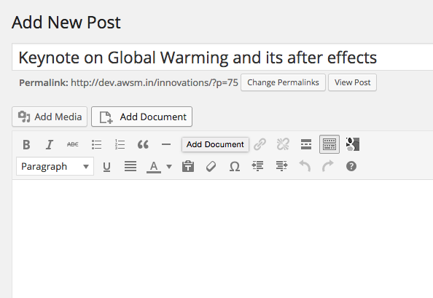
Seamless integration

Slide 3
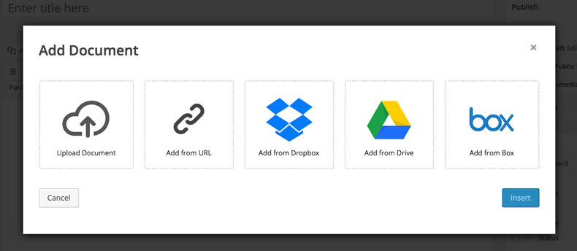
Straightforward and Clutter Free UI

Slide 4
All document types supported

Slide 5
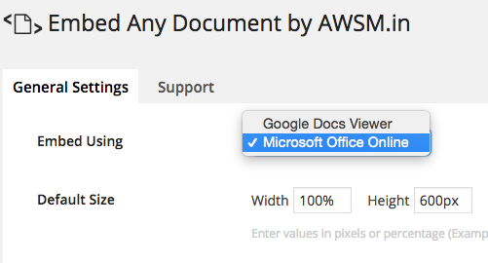
Option to choose the viewer interface

Slide 7
awsm.in

